Slide 1
NEW ABCD IN BUSINESS LANGUAGE IN RISK MANAGEMENT & CYBER SECURITY
PRESENTATION
BY
FCMA SRINIVASARAGHAVAN

Slide 2
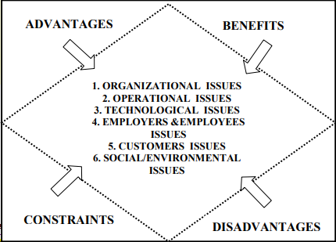
ABCD ANALYSIS FOR BUSINESS MODELS

Slide 3
New ABCD Model…
ABCD Model. Is also a Time Critical Risk Management (TCRM) Model.. which consists of..
A – Assessing the situation
B – Balancing the Resources
C – Communicating to Others
D – Do and Debrief the Events
Though mainly used in ORM ,now many started using TCRM –ABCD Model in Business Risk Management as well..

Slide 4
Assessing the Situation…
Requires accurate perception of a situation
Good Self assessment
Ability to fully understand a situation
Apply appropriate, available resources quickly and effectively

Slide 5
Balancing the resources
Use optimal use of the available resources
Identify skill set
Make proper planning
Give proper Training
Use the appropriate resources at the appropriate Time

Slide 6
Communicate to others
Communication is key to business process
Proper communication at all levels
Be clear without ambiguity
Before communicating one should know:
who needs to know what
who can do what
who can help or assist you

Slide 7
Do and Debrief…
Have a mission
Identify what works and what does not work
Do and Execute the plan
Debriefing includes learning , recording and disseminating the various risks
Use appropriate Risk Mitigation plan

Slide 8
Major Business Risks
Financial Risks
Credit Risk
Market Risk
Interest Rate Risk ,
Currency risk
Liquidity Risk

Slide 9
Major Business Risks …
Operational Risks
People Risk
Process Risk
Compliance / Legal Risks
Governance Risk
External Event risk – Geographical / Climatic
Systems Risk

Slide 10
Risk Management
Risk Management includes
Identifying
Assessing
Controlling
Financial, legal, Strategic ,Operational & Security aspects of an organization.

Slide 11
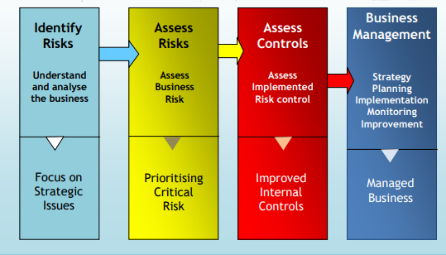
Risk Management..

Slide 12
Risk Management…
A successful Risk Management system / Risk Mitigation includes
Identify and Consider all types of risk
Take steps either to accept , reduce, avoid ,
Hedge or Transfer Risk
Have effective controls
Implement & Monitor the Controls

Slide 13
MAJOR CYBER THREATS IN BANKS /FINTECHS
Data Breach
information is stolen or taken from a system without the knowledge or authorization of the system's owner.
DDoS Attack
Distributed Denial of Service attack – Owners or denied access to network/Server for some time and perpetrators does fraud
Phishing Attack
The practice of sending fraudulent communications that appear to come from a reputable source. It is usually done through email.
Malware Attack
Malicious software executes unauthorized action in the system

Slide 14
MAJOR CYBER THREATS IN BANKS /FINTECHS ..
Ransomware.
It is a malware designed to deny a user or organization access to files on their computer. By encrypting these files and demanding a ransom payment .
Spoofing
Involves scammers pretending to be someone else to steal data or money or to spread malware
Insider Threats.
Malicious attack perpetrated on a network or computer system by a person with authorized system access.

Slide 15
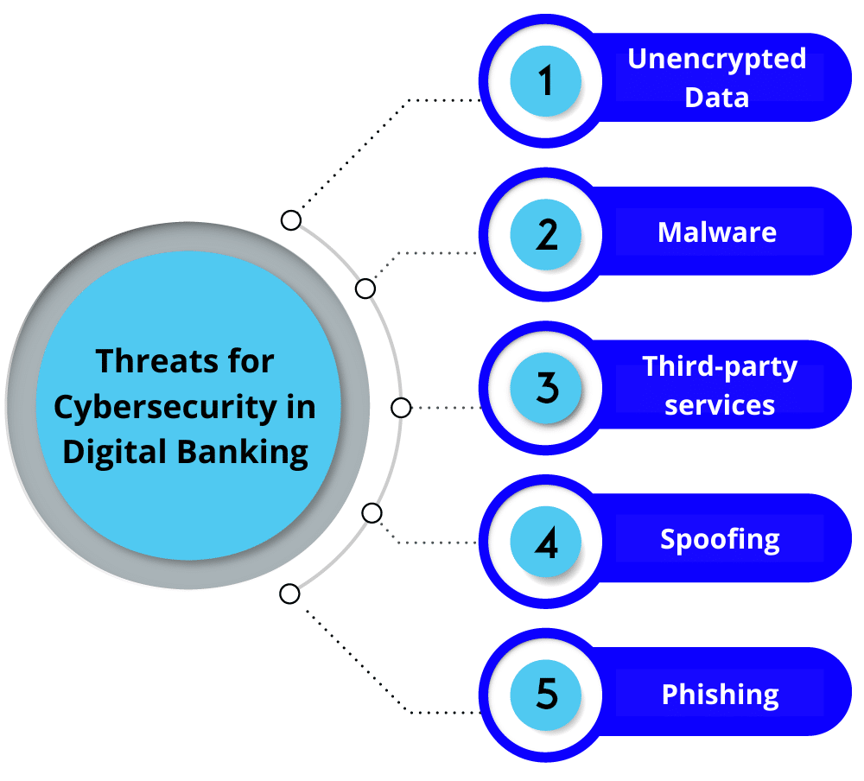
Cyber Threats

Slide 16
Cyber Security Mitigation Measures
Creating data backups and encrypting sensitive information.
Updating all security systems and software.
Conducting IS audit and take appropriate measures
Continuous Monitoring and checking audit trails
Conducting regular employee cybersecurity training.
Using strong passwords and changing it periodically
Installing firewalls.
Reducing attack surfaces –(ENTRY POINTS)
Assessing your vendors
Creating solid cyber risk policies and strategies.
Protecting your physical premises.

Slide 17
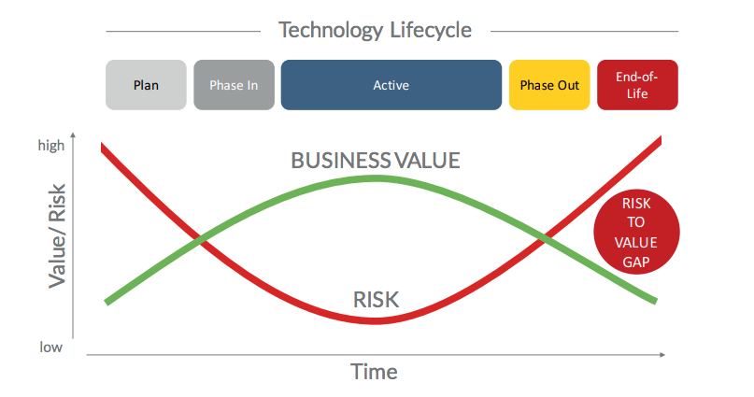

Slide 18
Risk Management..
Thank you

