Slide 1
The Institute of Cost Accountants of India
“Indian Corporate Legal Framework- Wings to fly high"
Cost and Management Accountants
Technical Session on Corporate Social Responsibility
Ms. Madhuri Lele

Slide 2
A different perspective:
Other than legal, Governance angle
Aware audience
My background / expertise
Touching on CSR Gambit

Slide 3
CSR – A Legal Mandate April 1, 201 4 India - The first country
Mandatory CSR in India: A Bad Proposal
Stanford Social Innovation Review
https://ssir.org/articles/entry/mandatory_csr_in_india_a_bad_proposal
Mandatory CSR in India: help or hindrance?
https://www.eco-business.com/news/mandatory-csr-india-help-hindrance

Slide 4
CSR – A Legal Mandate
India's new CSR regulations make philanthropy compulsory for companies
New CSR rules replacing comply-or-explain regulations with a mandatory regimen have raised the stakes for large corporations
Last Updated at February 9, 2021
https://www.business-standard.com/article/companies/new-csr-regulations-the-rise-of-compulsory-philanthropy-in-india-121020801724_1.html

Slide 5
Was there a total vacuum before 2014 …… ?

Slide 6
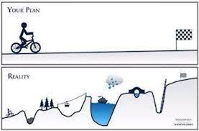
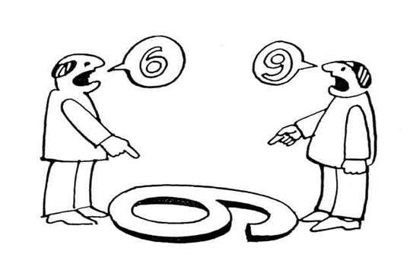
Long and Arduous walk - Lack of clarity

Slide 7
COVID – 19 and CSR
Crisil Yearbook 2021
CSR spend in India: In just 7 years has crossed Rs 1 lakh crore milestone
40% of this incurred in just the past two fiscals – COVOD-19 impact
Sectors: Manufacturing, Energy and Financial Services accounted for over 60% of the spending
Major areas: education and skill development, and healthcare and sanitation 53%
Rural development 9%
Fiscal 2021: the share of pandemic related CSR spending is estimated to have climbed to 62%, leaving little for other causes

Slide 8
COVID – 19 and CSR
CSR Spend | Crore | Listed Companies | Crore | Unlisted Companies | Crore
Fiscal 2020 | Rs 21,231 | 1,387 | Rs 14,431 | 19,962 | Rs 6,800
Fiscal 2021 | Rs 22,000 | 1,700 | Rs 14,986 | -- | Rs 7,072

Slide 10
Service Sectors
Hotel Industry:
2014-15 Rs.10066 Cr
2017-18 Rs, 13664 Cr
Data source : National CSR Portal (GOI)

Slide 11
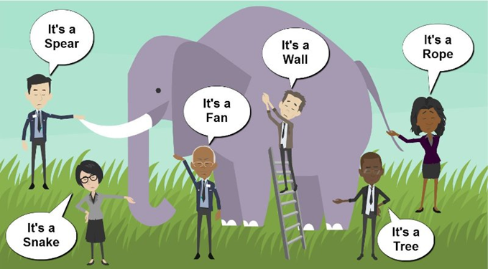
A known ELEPHANT in the Room?!! !

Slide 12
Need to
look
at CSR as
Product Design

Slide 13
The purpose of Product Design in business includes:
Premium quality product and brand value
Ideate products
Solution
Profile of the product

Slide 14
CSR Projects and Teams
CSR Projects
CSR activities to be aligned with the activities of the business
Equal emphasis to be given to CSR projects as Business Activities and principles of Product Design
Must be Top Down
CSR team :
Internal team
Outsourced
Hybrid working
Training being Integral and Ongoing part

Slide 15
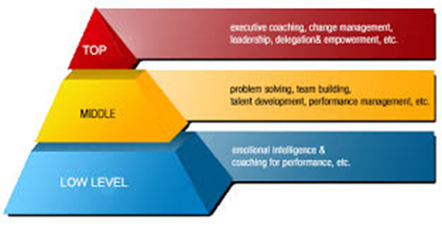
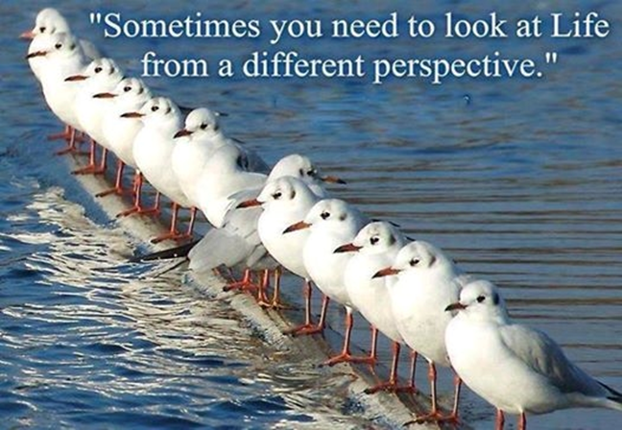
CSR and Training
Attitudinal and Behaviourial Training and Changes : Across the organization including top management
Contribution or giving back to The Society is or Too is business fundamentals / savvy
Repetition – Sustenance inbusiness is challenging / stressful

Slide 16
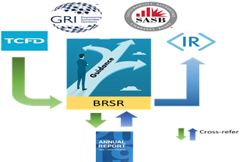
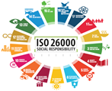

Slide 17
BRSR & SDGs : Parallels
BRSR Principles
SDGs

Slide 18
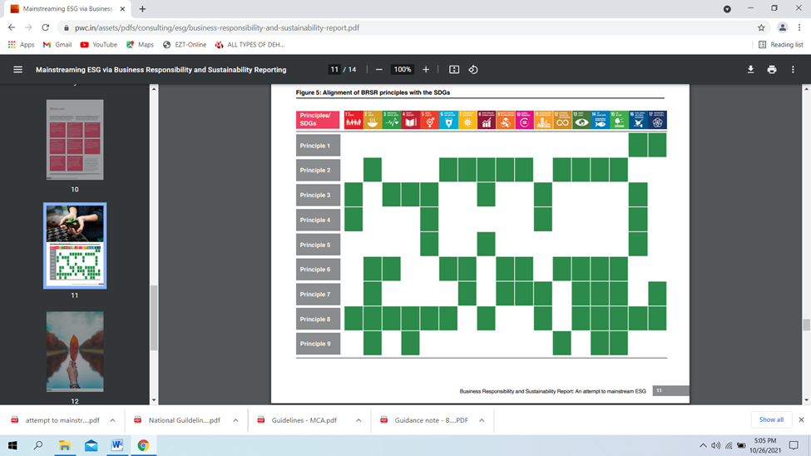

Slide 19
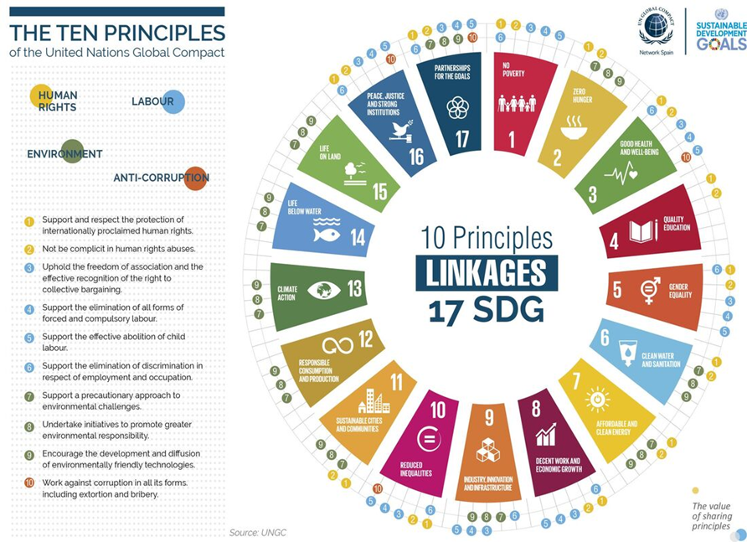

Slide 20
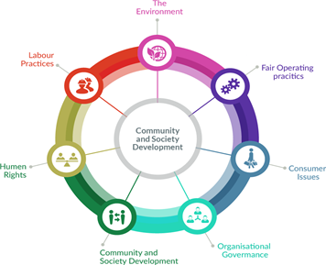
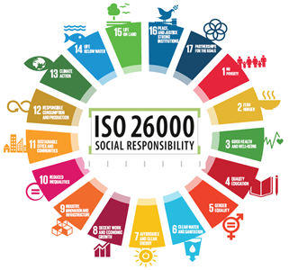

Slide 21
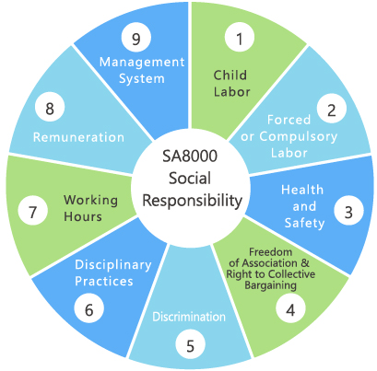
1 Child Labor
2 Forced or Compulsory Labor
3 Health and Safety
4 Freedom of Association
5 Discrimination
6 Disciplinary Practices
7 Working Hours
8 Remuneration
9 Management System

Slide 22
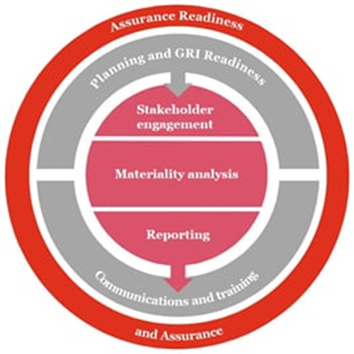
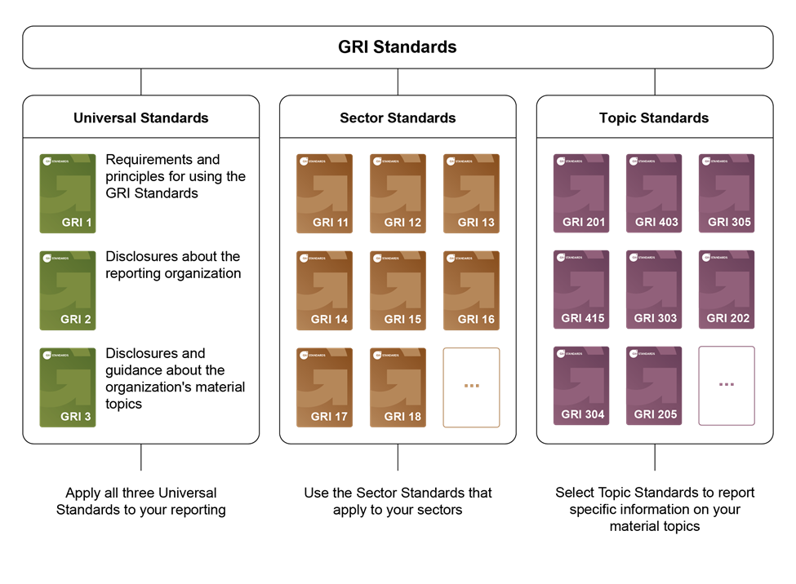
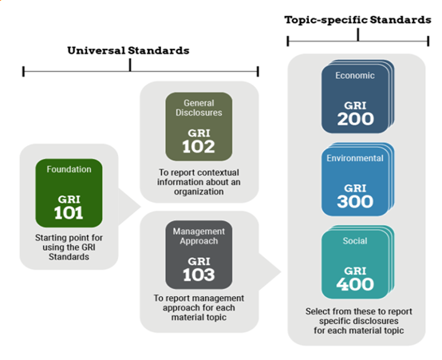

Slide 23
UN SDGs
Strongly Aligned
Aligned Misaligned Strongly Misaligned

Slide 24
Process
Align the CSR cause with the overall corporate strategy
An ad-hoc year-on-year allocation of funds
Arduous searches for credible and efficient implementation partners
Better resources allocation
Business value of social impact efforts
Clear and detailed Exit Strategy
Creating a cohesive and comprehensive long-term CSR strategy
Crystalize CSR Policy
Defining a clear goal in terms of a focus area, such as education, health, or sustainability

Slide 25
Process
Geographic location
Identifying impactful programs
Insufficient monitoring and evaluation structures
Long-term vision for CSR initiatives, detailing the guiding tenets of the company’s CSR policy
Moving from and beyond social value to performance
Reporting and effective Communication to stakeholders
Strategic decisions
Team commitment and accountability
Tracking mechanism

Slide 26
Tracking Mechanism
An effective tracking mechanism features:
Measurable outcomes: Well-designed KPIs
Time-bound measurements: Developing dashboards and a tracking mechanism for outcomes at regular intervals
Team accountability: a capable and self – directed team with accountability
A review mechanism: Regular reviews of outcomes with key stakeholders, continual guidance and course correction
Willingness to adapt: Willingness and ability to change

Slide 27
CSR Strategy, Monitoring and Assessment
A definition of what CSR is to your company – Mandatory or otherwise
Adopting one or more interventions
Competency evaluation (of team / Outsourced agencies)
CSR Impact Assessment: All pillars: Enables clarity, sets roadmap, clear indicators and directions
Integration in routine activities
Legal requirements where applicable
Outcomes: Authenticated through assurance audits and credible reporting
Qualitative and quantitative data generation and verification
Real and Sustainable change through monitoring and reviews
Risk mitigation: Clarification between responsibility / accountability and philanthropy
Stakeholder’s engagement

Slide 28
Assessment must consider
How well the social responsibility is integrated into the routine activities
Which vertical CSR team is tacking:
Environment, Labor & Human Rights, Ethics,
Legal requirements where applicable
The stakeholders engagement

Slide 29
Value Creation
For the first time ever, CEOs named societal impact as the top success factor for annual performance (Deloitte Consulting LLP’s 2019 Global Human Capital Trends survey)
As Larry Fink argued in his 2020 letter to CEOs, “A strong sense of purpose and a commitment to stakeholders helps a company connect more deeply to its customers and adjust to the changing demands of society. Ultimately, purpose is the engine of long-term profitability.”

Slide 30
Key areas of value creation from CSR
Brand differentiation
Talent attraction and retention
Innovation
Operational efficiency
Risk mitigation
Capital access and market valuation

Slide 31
Key areas of value creation from CSR
Brand differentiation:
Social purpose drives consumer purchasing decisions
Enable companies to charge a price premium
Increased revenue
Talent attraction and retention:
Employee engagement
Improved profitability
Higher productivity and cost reductions
Innovation:
Integration
Organic and Inorganic growth
New products and new markets
Higher revenues

Slide 32
Key areas of value creation from CSR
Operational efficiency:
Positive impact on utilities, lower waste generation, higher yields
Risk mitigation:
Enables environmental and social risks awareness
Operational performance challenges
Capital access and market valuation:
Positive impact on valuation and cost of capital

Slide 33
CSR Reporting
The CSR Report Checklist:
Letter from the CEO – History and special message, if any, CSR team
Business Overview – Operations, recent performance
CSR Strategy – Present and future goal
Transparency – Trust building
Authenticity – Internal and external influences & aspects
Sustainability Goals - Selection and overview
Stakeholder Engagement & Communication
CSR Management system
AND
Awards, Recognitions

Slide 34
Alignment with business
Integrating CSR into the corporate strategy by leveraging business capabilities and societal needs to create shared value: HUL’s Project Shakti

Slide 35
Clearly defined exit strategy: Tata Chemicals Ltd: Disinvestments in Babrala and Haldia plants
At Babrala: New incumbent: Yara Fertilizers
Disinvestments in Babrala and Haldia plants
Projects ranged from healthcare, water, and sanitation to education, skilling, livelihood generation, and conservation
Joint governance system for managing the projects
Secured funding from its partners
Tracking each program on key performance areas
Helping establish Yara’s own trust
Yara absorbed all program and field staff at the end of the one-year contract

Slide 36
Clearly define an exit strategy: Tata Chemicals Ltd: Disinvestments in Babrala and Haldia plants
At Haldia:
where other developmental agencies were also operating, TCL reviewed each program to ascertain the end stage and scaled them down for a time-bound handover to either the community, a government agency, or partner organizations
At both Babrala and Haldia, TCL secured the sustainability of the community, its people, and its developmental assets

Slide 37
Areas to look into
The Logical Framework Matrix (Logframe)
The results of the stakeholder, problem, objectives and strategy analysis are used as the basis for preparing the Logical Framework Matrix. The Logical Framework Matrix (or more briefly the logframe) consists of a matrix with four columns and four (or more) rows, which summaries the key elements of a project plan and should generally be between 1 and 4 pages in length. However, this will depend on the scale and complexity of the project.

Slide 38
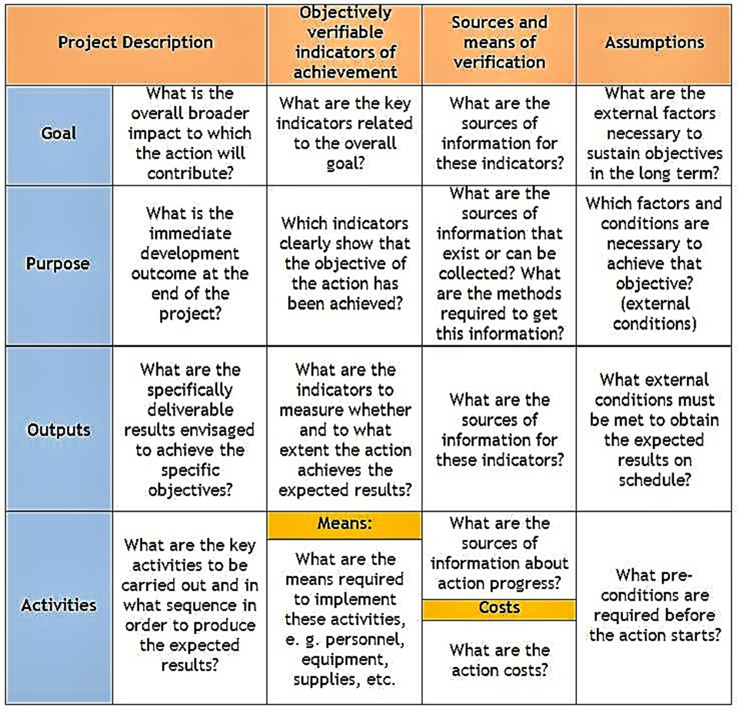

Slide 39
Areas to look into
Social Stock Exchange
Funding for NPOs, Social Enterprises and other finance generating options
National CSR Awards:
President of India Confers, President Shri Ram Nath Kovind First National Corporate Social Responsibility (CSR) Awards for outstanding contributions in the area of CSR Companies indulged in CSR activities are wealth creators, says Finance Minister 29-October-2019

Slide 40
Why CSR?
Job creations – isn’t it a service to soceity : although with profit as focus

Slide 41
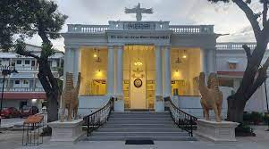
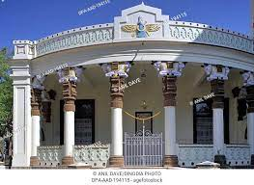

Slide 42
What are you
Building
Creating
Leaving behind as A Legacy
Dharohar

Slide 43
Thank you
Madhuri Lele
servensolve@gmail.com
+9193217 83505

