Slide 1
INTRICACIES OF COST AUDIT & COST RECORD RULES ON DIFFERENT SECTORS
SESSION-IV – STEEL SECTOR
CMA Ch Leela Srinivas, DGM (F&A),
RINL, Visakhapatnam Steel Plant

Slide 2
Plan of Presentation
Iron & Steel Manufacturing Process
Steel Costing Process in ERP/SAP
Companies (Cost Records & Audit) Rules Steel Industry
Q & A - Chatbox
Mail: leelasrinivaschasetti@gmail.com
Mobile & Whatsap:9490132374

Slide 3
Iron & Steel Manufacturing Process

Slide 4
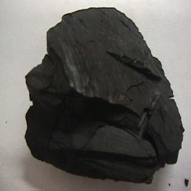
Coke Making
The conversion of Bituminous coal to Coke takes place by the process of carbonization, which consists of heating the coal over 1100^{O}C in a closed chamber in absence of Air in Vertical Coke Oven Batteries.
Coke is a hard and porous mass.
Approximately 15 to 17 hours required for each pushing
Raw CO Gas, Crude Benzol, Crude Tar, Ammonia are the by-products. Coke is sorted to BF Coke, Nut Coke, Coke Breeze and Coke Dust and Coke Sludge.
40 ATA Steam is collected in Coke Dry Cooling Plant and is used for generating Electricity through Back Pressure Turbine System(BPTS)
Very good quality coke should have >85% fixed carbon, <10% ash, <2% volatile matter, 0.6–1.5% Sulphur and 0.04% Phosphorus. Roughly 1.8 Tons of Coal (in a blend of 55% HCC,40% SCC & 5% MCC) is required to produce 1 Ton of Coke.
Coke acts as a fuel to provide heat for requirement of endothermic chemical reactions and melting of metal and slag.

Slide 5
Coal Chemical Process
Crude Tar
Raw CO Gas
Clean CO Gas
PITCH
PITCH CRESOTE MIXURE
Crude Benzol
Ammonia
MH PITCH
BENZENE
Ammonia Sulphate
BF PITCH
NAPTHALENE FRACTION
HP Naphthalene
& DN Oil
TOLUENE
COAL TAR WASH OIL
LIGHT SOLVENT OIL
SOL-110
(NON AROMATICS)
PHENOL FRACTION

Slide 6
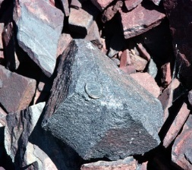
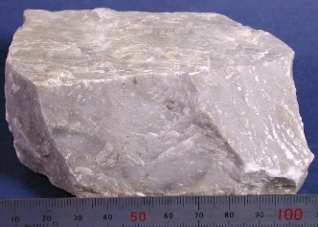
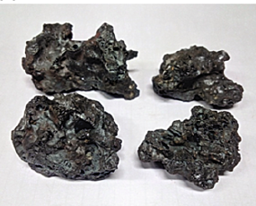
Sinter Making
Base Mix is prepared using Iron Ore Fines, Iron Ore Slime, Sinter Returns, Metallurgical Waste, Lime Stone, Dolomite, Coke Breeze.
Sinter is made from Base Mix, Sinter Returns and Sized Iron Ore Returns
Iron Ore
Flux
Iron Ore (Fe2O3) contains 70% Fe and 30% Oxygen.
Iron ore starts melting at 1100–1150 °.

Slide 7
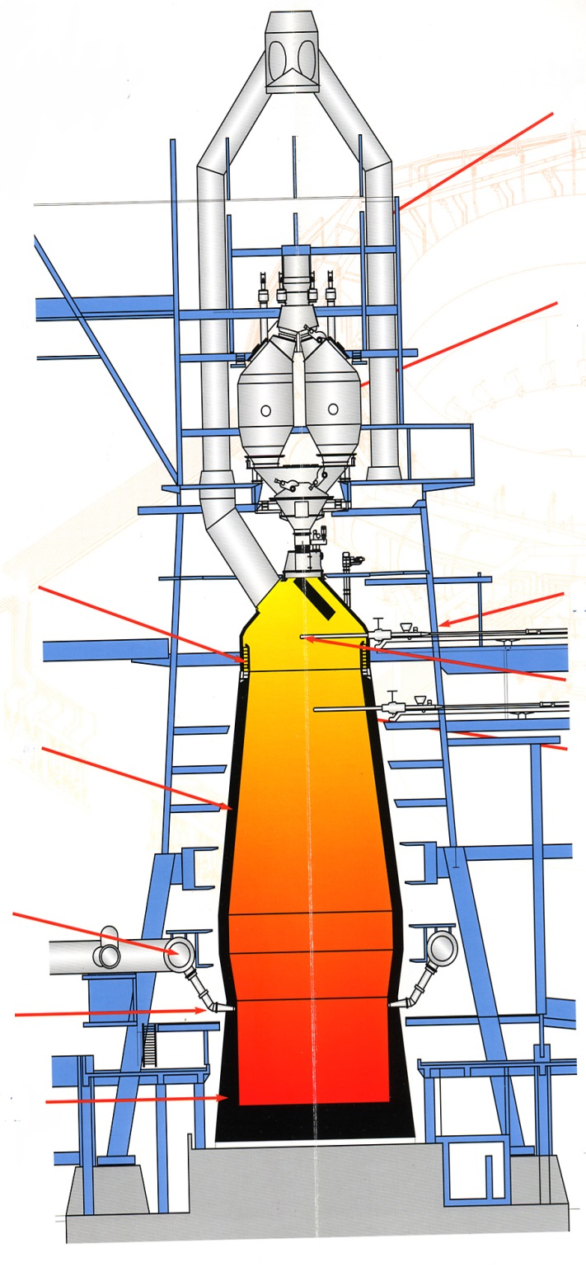
Operation Over-View :
The Blast Furnace Process
1. The Iron Ore, Coke and Limestone, (the Charge), is conveyed to the top of the Furnace.
2. The Charge is stored in Bells until the timing is right for the charge to be dropped into the Furnace.
3.Hot air is then blown through pipes called Tuyeres, to fire the mixture.
4.The Coke burns to increase the temperature in the Furnace upto 1700 °C.
5. The Limestone attracts the impurities in the Iron Ore and forms Slag and become fully liquid at 1350–1400 °C This Slag is lighter than the molten Iron and so floats on top of it.
6. As the Furnace fills, the molten Iron is Tapped off. The Slag is also tapped off at regular intervals.
7. Most Iron is taken straight from the Blast Furnace to the Steel Mill, but some is poured into buckets called Pigs. This Iron is called Pig Iron and is used to make Cast Iron.
Top Gas Mains
Top Bins
Above Burden Probe
Throat Armour
Temperature Probe
Refractory Lining
Sub Burden Probe
Bustle Main
Tuyeres
Hearth Refractories

Slide 8
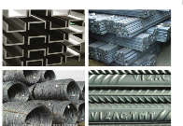
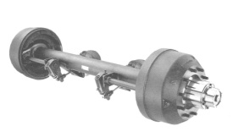
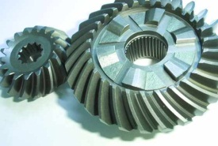

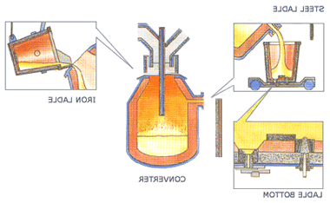
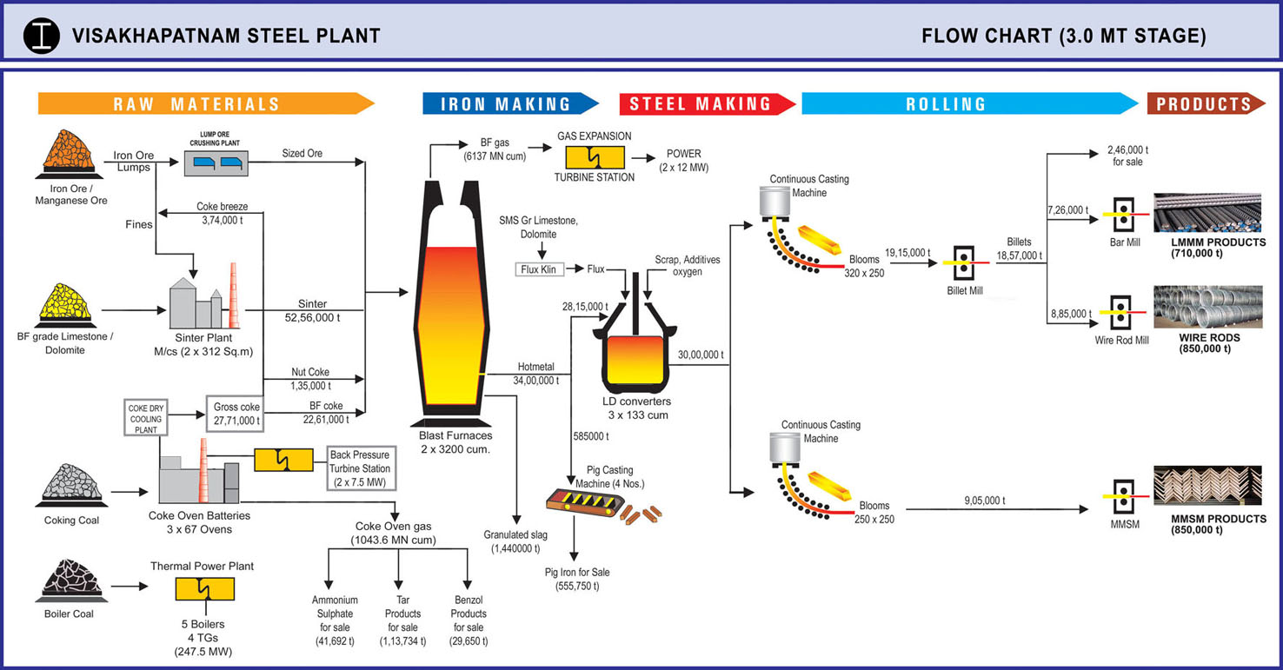
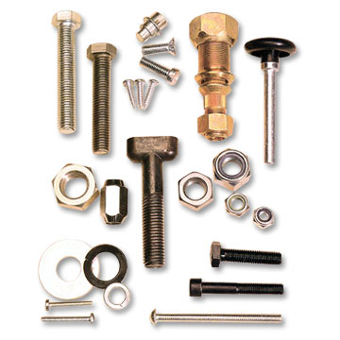
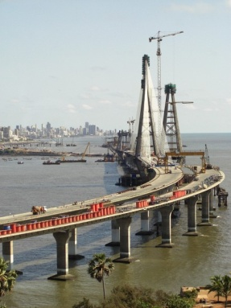
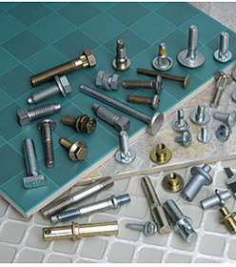
Process flow – Integrated Steel Pant
Raw materials
Coke
Sinter
Sized Iron Ore
Lime Stone
Ferro Alloys, Aluminum for Grade of Steel added
Oxygen
Bar Mill
Hot Metal
Liquid Steel
Crude Steel
WRM
Blooms/Billets for sale
Slag
Pig Iron
Blast Furnace
Converter
Caster
Strls
8

Slide 9
Power & Utilities
Captive Power Generations:-
Thermal Power Plant – Boiler Coal Based Power
Gas Based Power Plant – BF Gas from BF
BPTS from Waste Gas of Coke Ovens
GETS & TRT from Blast Furnace Waste Gas
Steel making requires continuous supply of power as heavy equipment have to run without hampering production. In case of internal failure, external power is used by purchase from Electricity Boards.
Air Separation Plant:-
Oxygen, Nitrogen and Argon gas are required for usage in Coke ovens, Sinter Plant, Blast Furnace for enrichment.
Compressed Air:-for Operation and service purpose
Chilled Water Plants:- for cooling purpose
Soft Water & DM Water:- for usage in Steam generations

Slide 10
Services
-:Production Services:-
Energy Management
Environment Management
Production Planning & Monitoring
Quality Assurance & Technology
Rolls & Roll shops
Raw Material Management
Rawmaterial Handling Plant
Structural Engineering
Scrap & Salvage
Traffic Department
Water Management
-: Maintenance Services:-
Air Condition Services
Civil Engineering
Structural Engineering
Central Maintenance Electrical
Central Mechanical Maint.,
Capital Repairs Group
Calcined & Refractroy
Distribution Net Work
Electrical Repair Shop
Engineering Services & Foundry
Electro Technical Lab
Field Machinery Department
IT & ERP
Instrumentaion
Lubricants & Hydraulics

Slide 11
Steel Costing Process in ERP/SAP

Slide 12
Enterprise Resource Planning (ERP)
Bringing the Organization Together
ERP – integrates (or integrated set of IT systems) so that employees can make enterprise wide decisions by viewing enterprise wide information on all business operations (enterprise wide information)
Keyword in ERP is “enterprise”
ERP systems focus on all processes, departments and operations for the entire enterprise

Slide 13
Enterprise Resource Planning
ERP systems correlates the data generating an enterprise wide view that is consistent and real-time.
It is involved in sourcing, producing and delivering a company’s product
Major components focus on Accounting/Finance & Controlling (FICO), Production (PP), Materials management (MM) ,Human Resources (HR), Sales & Distribution (SD)
Extended components typically focus on and require interactions with customers, suppliers and business partner.
Typically Internet operations are enabled. HANA, will be on Cloud basis.

Slide 14
Configurations in SAP
Company Code
Controlling Area
Operating Concern
Plant
Sales Office
House Banks
Depreciation Keys
OBYC settings transaction key wise
Notes:
An ERP system provides a method for effective planning and controlling of all the resources required to take, make, ship, and account for customer orders in a manufacturing, distribution, or service organization.
What happens when sales and marketing departments are working from two different sets of customer information and product information?
Would the marketing campaigns be accurate?
Would sales be able to deliver the products it sells to its customers?
Enterprise resource planning systems provide organizations with consistency.
The key word in enterprise resource planning is enterprise.
SCM systems focus specifically on suppliers
CRM systems focus specifically on customers
ERP systems focus on everything, all processes, departments, and operations for an enterprise
ERP systems encompass everything, including SCM and CRM.
ERP enables employees across the organization to share information across a single, centralized database. With extended portal capabilities, an organization can also involve its suppliers and customers to participate in the workflow process, allowing ERP to penetrate the entire value chain, and help the organization achieve greater operational efficiency
One database that supports the entire organization could eliminate many of the issues mentioned on the previous slide
However, there are also issues could be caused by having one database that supports the entire organization?
Not as flexible and far more difficult to change
Might not meet all department needs as well as an individual specific system
Multiple access levels increases security issues
Ethical dilemmas from accessing different department information – such as payroll

Slide 15
Transaction Code in SAP
Is a code through which system allows to perform a specific activity on a pre-setting in the system.
Example:-
- F-02 – GL account posting
- ME21 – Creation of Purchase Order
- MIGO – Goods Receipt against PO
- MIRO – Incoming Invoice against PO
- FB60 – Direct Vendor Invoice
In HANA, instead of T-Codes, ICONs facilitated

Slide 16
Integrated Data Flow to FICO in SAP
Whenever a user performs a transaction code, if an accounting entry is generated, the relevant FICO records are updated based on Accounting Document and Controlling Document.
MIGO – Used for Goods Receipt
A/c Entry – Inventory Debit & GR/IR A/c Credit
MIRO – Used for Incoming Invoice
A/c Entry - GR/IR A/c Debit & Vendor A/c Credit

Slide 17
Controlling in SAP
Controlling deals with Management Accounting which is an internal and integrated accounting in an organisation.
Internal accounting consists of Cost Element accounting (CE), Cost Center accounting (CC), Product Costing (PC), Profitability Analysis (PA).
Product costing includes accounting of costs against production orders.
Materials related cost elements are posted to production orders and other cost elements are posted to cost centers. Cost center costs are transferred to cost objects like cost centers, production orders, internal orders, WBS elements based on statistical key figures (SKFs)

Slide 18
Controlling in SAP
Materials include Raw Materials, Stores and Spares, Semi-finished goods(SFG), Finished Goods(FG)
Raw Materials consumed for producing SFG,FG are directly charged to Production orders through Bill of Materials (BOM).
All Raw Material issues & Utilities against each Production Order are part of BOM
Production orders contain Bill of Materials (BOM) and Routing (Cost Center Activities).
Conversion costs are allocated to Production orders through Routing of each Production order. Inputs for Routing are from Activities of the Cost Centers.

Slide 19
Production Order
Production Order : A production order contains sequence of operations and each operation describes how to carry out a workstep. A production order contains all the information required for producing targeted/planned quantity of material.
A production order determines the following:
● Which materials are used and when they are used
● Which Work centers assigned to cost center (operations and sub- operations are performed at work centers). Work centers are defined in PP
● The dates when these operations are carried out
● Which stock materials are required to carry out the operations
● Which materials and activities must be procured externally for the order
● The receivers to which the actual costs can be settled
Contd..

Slide 20
Production Order (contd..)
The Material consumption for the out put in a Production Order is defined as Bill of Material (BOM).
The Activities required to produce the output material are defined in Routing.
Cost of all BOM Materials are posted to Production Orders on confirmation of their consumption against an output through Material Management(MM) in SAP.
Routing costs (Activity costs from Cost Center) are posted to Production orders at standard cost for the actual quantity confirmed.
Planned production orders are for the following purposes:
  To determine the planned costs for the material being manufactured based on the planned lot size of the order
  To calculate the planning variances and use them to decide what production version to use
- To be able to determine the production variances at a later time

Slide 21
Production Order (contd..)
Whenever the production (GR) or consumption (GI) and Activity is confirmed against a production order, the same are valued at Standard Price and necessary entries are passed in FI to inventorise the production as well as to credit the Activity Cost Center and to debit the Production Order.
Periodically the production orders status is changed to TECO/DLV Completed to enable to determine the actual Routing Costs for the production orders.
Adjustment on account of change in the cost from Standard Price to Actual Price are to be carried out in FI for the respective accounts in the Inventory (if the stock of respective FG/SFG is available or to Consumption (COGM/COGS) as applicable)
Subsequent price differences of input materials as per BOM are also adjusted to SFG/FG during Material Ledger process so that actual costs are determined for the particular period.

Slide 22
Actual Activity Costs
Every period end on completion of FI Entries for expenses, MM entries for Stores Consumptions, SES for Contracts, Depreciation etc., Cost Center costs are reposted, distributed wherever necessary.
Assessment iterative cycles are run for transferring Service Center costs to production cost centers and in turn production cost center costs to Activity Cost Centers. Statistical Key figures are the base for distributions and assessments.
The Costs so assessed in Activity Cost Centers are divided with the actual activity quantities in units like Tons, Rolling Hours, Heats, KNM,MWH etc., to determine the Actual Activity Rate per unit.
The Production Orders are revalued with these Actual Activity Rates.

Slide 23
Driving factors for implementing Material Ledger
Company want to evaluate inventories at periodic average cost.
Company has a history of huge price differences/escalations paid subsequent to receipt/consumption.
Current Prices for current consumptions will change due to these fluctuations.
Company want to amortize these purchase and production variances over the life of the inventories.
Company want to automate the process

Slide 24
Material Ledger features
  Multiple Valuation
  - Combine the benefits of Standard Price Control for preliminary valuation and Moving Average Price Control for Balance Sheet
  - Enable accurate periodic valuation
  - Settle proportionate price variances to period end inventories
  - Roll up (Single and Multi Level) price variances throughout the production process and up to the Sale of Product.

Slide 25
Product Costing
Manufacturing Cost
MM: RM
Cost
Center 1
Cost
Center2
CO-
CCA
BOM
CO-
PC
Cost
Center 3
Routing
Act1
Production
Cost Center
Production
orders
Act2
F. Goods
Inventory

Slide 26
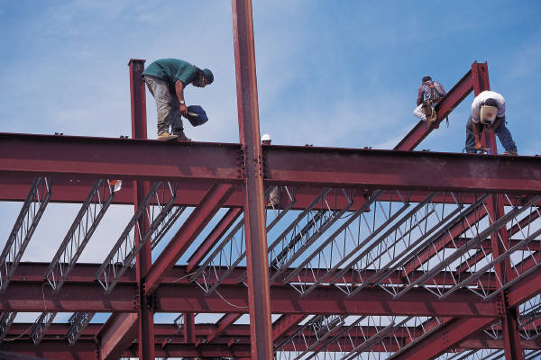






The Product’s Cost (Steel)
MATERIALS – BILL OF MATERIALS (BOM)
COST CENTER ACTIVITIES (ROUTING COST :Conversion Cost /Operating Cost)
Overhead
(Production related)
WOH & GOH

Slide 27
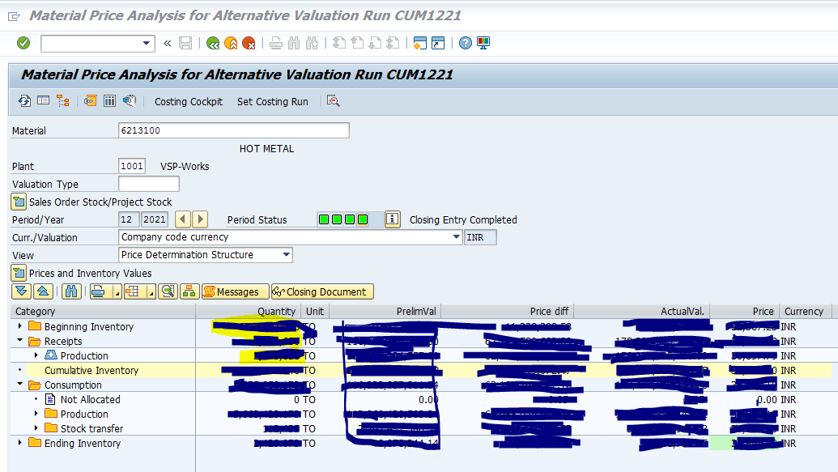
Material Ledger view

Slide 28
Companies (Cost Records & Audit) Rules
Steel Industry

Slide 29
Audit of Cost Records has been made mandatory since 2011-12 for Steel Plant vide Cost Audit Order No.52/26/CAB-2010 Dated.03-05-2011 issued by Ministry of Corporate Affairs (MCA) in exercise of power under section 233b of Companies Act 1956 based on Net-worth or Turnover.
Section 469 of the Companies Act, 2013 empowers the Central Government to make the rules carrying out the provisions of this Act. Section 148 of the Companies Act, 2013 empowers the Central Government to make the rules in the area of maintenance of cost records by the companies engaged in the specified industries. In exercise of the powers conferred by above sections, MCA Notified Companies (Cost Records & Audit) Rules, 2014 on 30.6.2014 & 31.12.2014 in supersession earlier rules.
(1) Short Title and Commencement, (2) Definitions (3) Application of Cost Records (4) Applicability of Cost Audit (5) Maintenance of Records (6) Cost Audit

Slide 30
Rule 3 Table (A) – Regulated Sectors (6) | Rule 3 Table (B) – Non – Regulated Sectors (33)
Records to be maintained if Turnover from all products and services is more than 35 Crs in the preceding FY | Records to be maintained if Turnover from all products and services is more than 35 Crs in the preceding FY
Rule 4 (1) Audit is applicable if Overall Turnover from all products and services is more than 50 Crs or more | Rule 4 (2) Audit is applicable if Overall Turnover from all products and services is more than 100 Crs or more
Rule 4 (1) Audit is applicable if Aggregate turnover of Individual product and service is more than 25 Crs or more | Rule 4 (2) Audit is applicable if Aggregate turnover of Individual product and service is more than 35 Crs or more
Rule 5 Cost Records to be maintained in Form CRA-1. No specific format for Cost Statements. Periodicity monthly, quarterly, annually.
Rule 6 (2) Intimation of appointment of Cost Auditor by the Company to Central Government in Form CRA-2.
Rule (4) Form of the Cost Audit Report CRA-3. Annexure to Cost Audit Report in Part-A, Part-B for Mfg Sec, Part-D
Rule 6 (6) Form for filing Cost Audit Report with Central Government CRA-4

Slide 31
Exemptions
Cost Audit shall not apply to a Company whose revenue from foreign exchange exceeds 75% of total revenue
Companies operating from Special Economic Zone
Companies engaged in generating electricity for captive consumption through ‘Captive Generating Plant’

Slide 32
Products covered for Audit in Steel Sector
Industry | Name of the Product | CTA Code
Steel | Pig Iron | 72011000
Steel | Blooms/Billets | 72071190
Steel | Blooms/Billets | 72071990
Steel | Flats | 72111410
Steel | Rebar Coils | 72131090
Steel | Plain Wire Rod Coils | 72139120
Steel | Plain Wire Rod Coils | 72139190
Steel | Forged Rounds | 72141090
Steel | Rebar | 72142090
Steel | Rounds | 72149990
Steel | Angles/Channels | 72161000
Steel | Channels | 72163100
Steel | Beams | 72163300
Steel | Angles | 72164000
Railway | LHB Forged Wheels | 86071910
Railway | Loco Forged Wheels | 86071920
Mineral Fuels (other than Petroleum) | Coking coal | 27011910
Mineral Fuels (other than Petroleum) | Crude Coal Tar | 27060010
Mineral Fuels (other than Petroleum) | Heavy Crude Benzol | 27071000
Mineral Fuels (other than Petroleum) | H.P.Naphthalene & D.N.Oil | 27074000
Mineral Fuels (other than Petroleum) | Phenol Fractions | 27075000
Mineral Fuels (other than Petroleum) | MH Pitch / PCM | 27081090
Mineral Fuels (other than Petroleum) | LSO, SOL-110 & STILL BOTTOM OIL | 27079900
Inorganic & Organic Chemicals | C.G.BENZENE | 29022000
Inorganic & Organic Chemicals | N.G.TOLUENE | 29023000
Inorganic & Organic Chemicals | Liquid Argon | 28042100
Inorganic & Organic Chemicals | Liquid Nitrogen | 28043000
Inorganic & Organic Chemicals | Liquid Oxygen | 28044090
Fertilisers | Ammonium Sulphate | 31022100

Slide 33
Installed Capacity – for Manufacturing Sector
In Integrated Steel Plants, upto Hot Metal stage, single product
Hot Metal (Iron stage) to Liquid Steel where Grade of steel is decided by addition of Ferro Alloys. Each grade is a product (appox..100 grades)
Liquid Steel is Casted in Casters for producing Crude Steel (Semi Steel i.e., Blooms of different sizes.. Sizes wise grades wise appox…500 products)
Semis (Blooms) are re-heated in Furnaces of Mills, like Billets Mill,Bar Mill, Wire Rod Mills and Structural Mills. (approx..1500 products)
Capacities are generally available at Hot Metal, Liquid Steel, Blooms, Billet, Bar, Wire Rod and Structural Mill level.
CTA wise Capacities are not envisaged in the designs.
CTA covers more than one product from different Mills based on the Chemistry of Steel like Carbon % in Steel.
It is not practicable to provide Installed Capacities at CTA level and Capacity utilizations to determine.
It is better to incorporate new para for reporting industry specific important Tecno-economics along with historical trends in order to assess the company’s strengths and weaknesses.

Slide 34
CTA wise Cost Sheets
Product-wise Cost sheets can be drawn from ERP/SAP data.
CTA is a combination of different products.
One CTA consists of different products from different Mills.
The Product-wise data is to be sorted based on CTA and to be reworked for CTA wise Cost Sheets.
As Steel Sector involves series of processes, CTA wise data extraction is a challenging task and time consuming and duplication of job for Cost Accountants.

Slide 35
Conclusions
Maintenance of Cost Records and Audit are absolutely necessary for efficient resource Utilisation as well as monitoring and improving the efficiency of organisations leading to overall productivity and profitability improvement in the best interest of consumers, investors, workers and industry, and the general public.
Cost audit is based on the economic principle that resources should flow into the most remunerative channels. Cost Audit measures the parameters indicating the effective efficiency in the utilization of financial, physical, human resources etc
‘Cost Audit’ brings out the weaknesses in the internal workings of a company and surfaces them out for the benefit of top management and other agencies for necessary action. Cost audit provides more accurate data as regards the cost of various items and the quantity of materials consumed, thus helping in the proper computation of variance and hence productivity. In a nutshell, ‘Cost Audit’ covers ‘Efficiency, Performance, and Propriety.

Slide 36
Q & A
CMA Ch Leela Srinivas, DGM (F&A),
RINL, Visakhapatnam Steel Plant
Mail: leelasrinivaschasetti@gmail.com
Mobile & Whatsap:9490132374

Slide 37
Thank you

